Slide 1


Employing parallel computing in data-intensive tasks
Adam Šmelko
Department of distributed and Dependable Systems
26. 9. 2024
Notes:
Dear members of committee, reviewers and all, my name is Adam Smelko and I welcome you at my phd defense
Rychlejsi prechod k pointe
Brusim okolo detailov …
Ukazovat mysou
Nehovorit I will not speak about this …
Viac porozpravat kontex v contribution map
Viac vysvetlit co je ta smart vec
Pridat viac usecases ku resultom
- highlight parts where c++ and noarr differ
- our research group
- more high level
- viac explicit ake su contributions
- viac ukazat tu navaznost
Second part as a consequence of first part – I wanted more general way of layouting in c++
Ku tym otazkam do publika

Slide 2

Thesis topics & contribution map
GPUs in scientific computation
HPC library for memory optimizations
Cytometry analysis
Systems biology
Signal Processing
Hierarchical clustering
Dimensionality reduction
Boolean networks
3. MaBoSS
Indexing & looping abstraction
2. EmbedSOM
5. Noarr Layouts
6. Noarr Traversers
1. Mahalanobis clustering
Distance matrices
Complex data accesses
4. Cross-correlation
Notes:
I would like to start with the general overview of the work presented in the thesis which I will show as a contribution map to bring the topics into broader context.
I divided the thesis into 2 parts, first being accelerating scientific computation on GPUs and the second one is HPC library for simplified optimizations programming.
first topic belongs to the domain of bioinformatics it is about special form of hier. Clustering, called maha clustering used for the analysis of single cell cytometry data. And it was added as the first contribution of my thesis because speeding up this computationally complex clustering could help analyze other than just very small datasets.
The second contribution is embedSOM. It is a tool for dimensionality reduction of cytomeyry data. The goal of this contribution was to use GPUs to enable real-time analysis.
Moving to the systems biology, a tool called maboss is used for simulating complex biological systems. In this contribution, runtime compilation feature of GPUs is used to simulate orders of magnitude bigger models than on CPU.
The last contribution in this part is related to gpu optimized cross-correlation, that beats asymptotically better algorithm for specific problem instances.
And the second part of the thesis gains the lessons learned from optimizing all the previous works and proposes a tool that helps programmer to develop optimized code more effectively – by providing a simpler, error-free, declarative way, that promotes software engineering principles.
To tackle complicated data access pattern and data structure layout.
This is the basic outline of this presentataion.
---- povedat: u tyzcho 4 zryhlit –pocedat preco…..
------ durha polka – chceme to zefektivnit pre programatorov
------ nech jasne zaznie – lessons learned
-- Sipka od GPU -> HPC

Slide 3
GPUs in scientific computation
Contributions 1-4

Slide 4


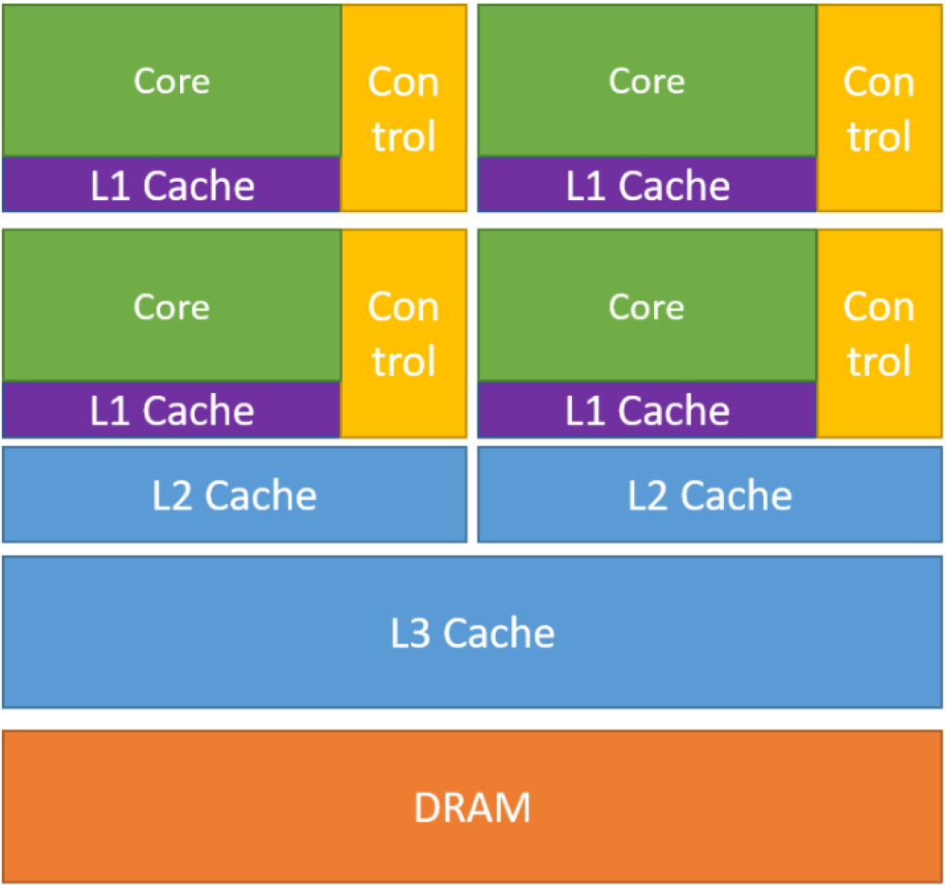
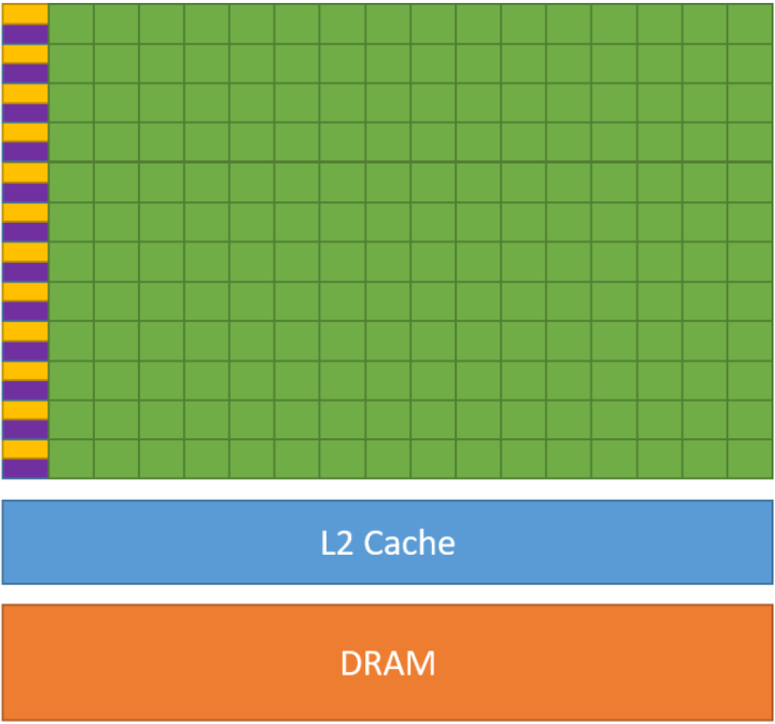
Graphics Processing Units
Massively parallel accelerators
Scalable chip design
Energy efficient (more ops per watt than CPUs)
Suitable for HPC workloads
CPU
GPU
16-64 cores Low latency
Good serial performance
Task parallel
100-1000 cores High throughput
Good for parallel processing
Data parallel
Source: Nvidia Programmer’s guide
Notes:
Why do we talk about GPUs and scientific computing.
Nowadays, gpus are sought after devices, which are put into almost every new supercomputer to increase their flops and with the advent of AI and LLMs, we can even say they are in short supply.
GPU houses thousands of simple cores and has much bigger memory thruput, which makes them suitable High Performance Computing, to which many scientific computation belongs.
Pointa prveho: je to tazke
Druheho: work inbalance –
Tretieho: memory
Pri kontrubbusnah pripomenut tieto problem ^

Slide 5
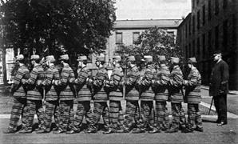
GPUs – Programming Model
Single Instruction Multiple Threads – SIMT
GPU runs thousands of threads, but …
... they execute in groups of 32
… one instruction at a time.
Poor load balancing can lead to a huge performance hit.
warp
lockstep
Notes:
However, writing a GPU-accelerated program is not as simple as copy pasting CPU code to some gpu coding framework and pressing build button.
GPUs are designed with their own programming model, SIMT and in many ways it resembles the SIMD model.
It means that the thousands threads running on these thousands of cores are not independent of each other,
They execute in groups of 32 called warp,
One instruction at a time in a process called lockstep.
So, same as in the picture, one thread can not move without the rest.
More specifically, if a thread chooses a different code path, the execution is serialized. This makes load balancing an important task when developing GPU implementations and choosing a wrong work distribution can hit the performance significantly.

Slide 6
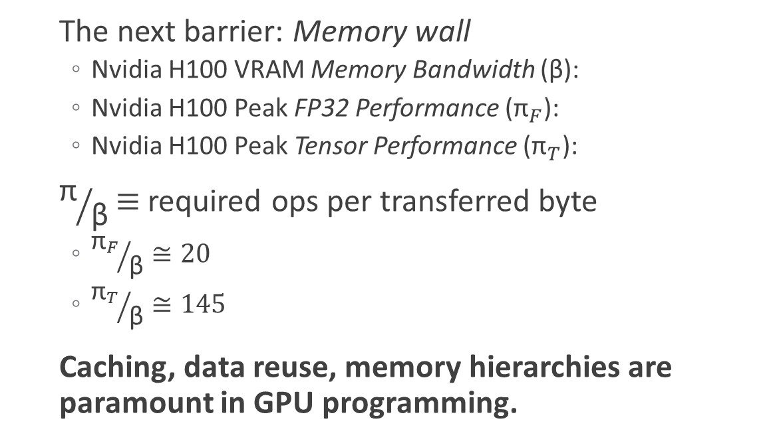
GPUs – Memory Hierarchy
The next barrier: Memory wall
Nvidia H100 VRAM Memory Bandwidth (β):
Nvidia H100 Peak FP32 Performance (${\text{π}}_{F}$):
Nvidia H100 Peak Tensor Performance (${\text{π}}_{T}$):
${\text{π}}/{\text{β}}$ $≡$ required ops per transferred byte
${{\text{π}}_{F}}/{\text{β}}≅20$
${{\text{π}}_{T}}/{\text{β}}≅145$
Caching, data reuse, memory hierarchies are paramount in GPU programming.
3.4 TB/s
67 TFLOPs
495 TFLOPs
Source: Nvidia Programmer’s guide
Notes:
To make things worse, there is another typical barrier when optimizing a code on GPUs – the memory wall.
See the difference between memory bandwidth and compute bandwidnth of one of the latest nvidia gpus.
The numbers differ by one order of magnitude.
If we divide these numbers, we get number of math operations that we need to perform for a single transferred byte to not be bolltenecked by the memory.
And 20 is a lot. And if we add tensor cores into the equation, optimized for matrix multiplication, the number grows much higher.
To alleviate this problem, GPUs have multilevel memory hierarchy. The most notable part is the shared memory – compared to CPUs we can say that it is equivalent to L1 cahce – however, shared memory is a programmable cahce.
GPUs have ways to give programmers a big control over caching. Because caching, caching data reuse and utilizing memory hierarchies is very important when trying to squeze the most of GPU

Slide 7
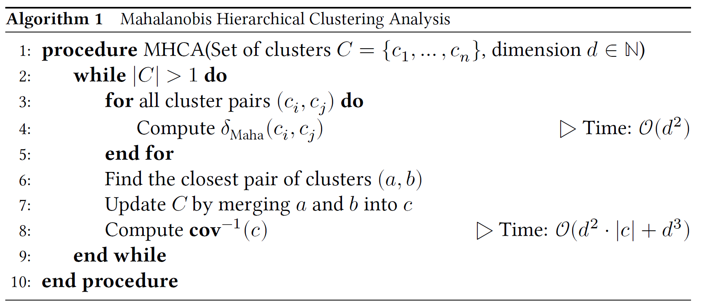
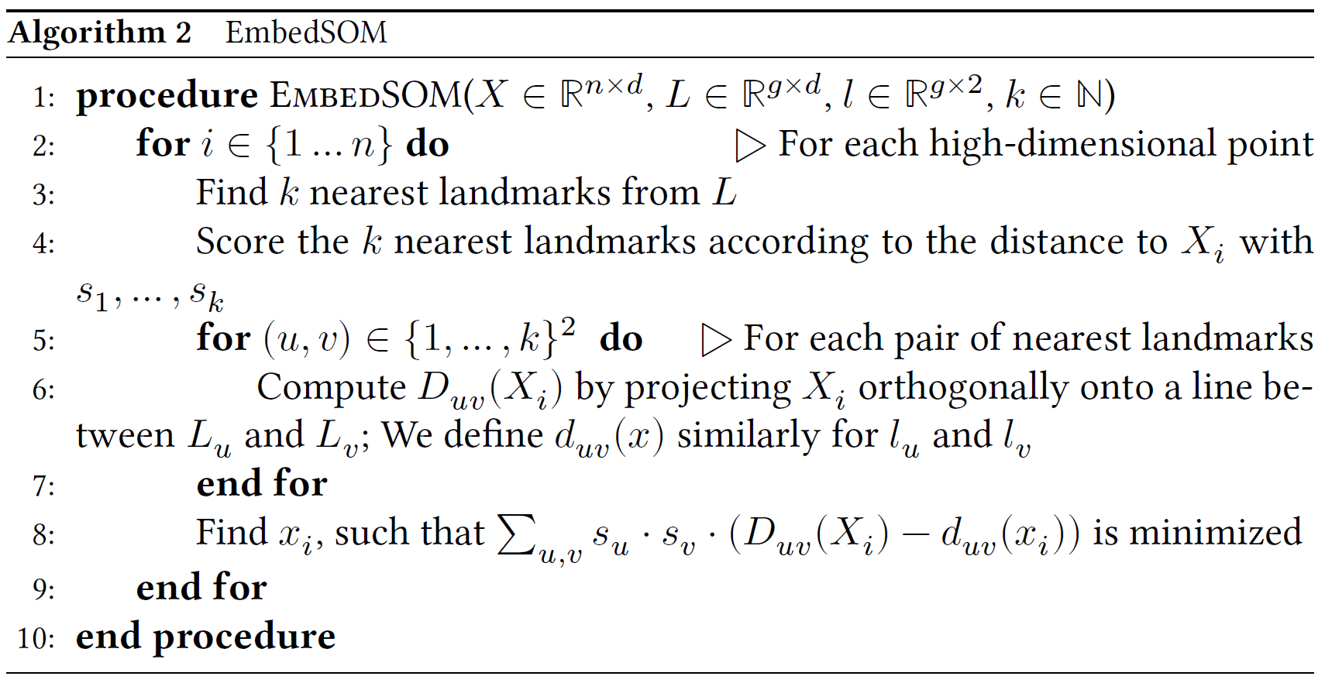
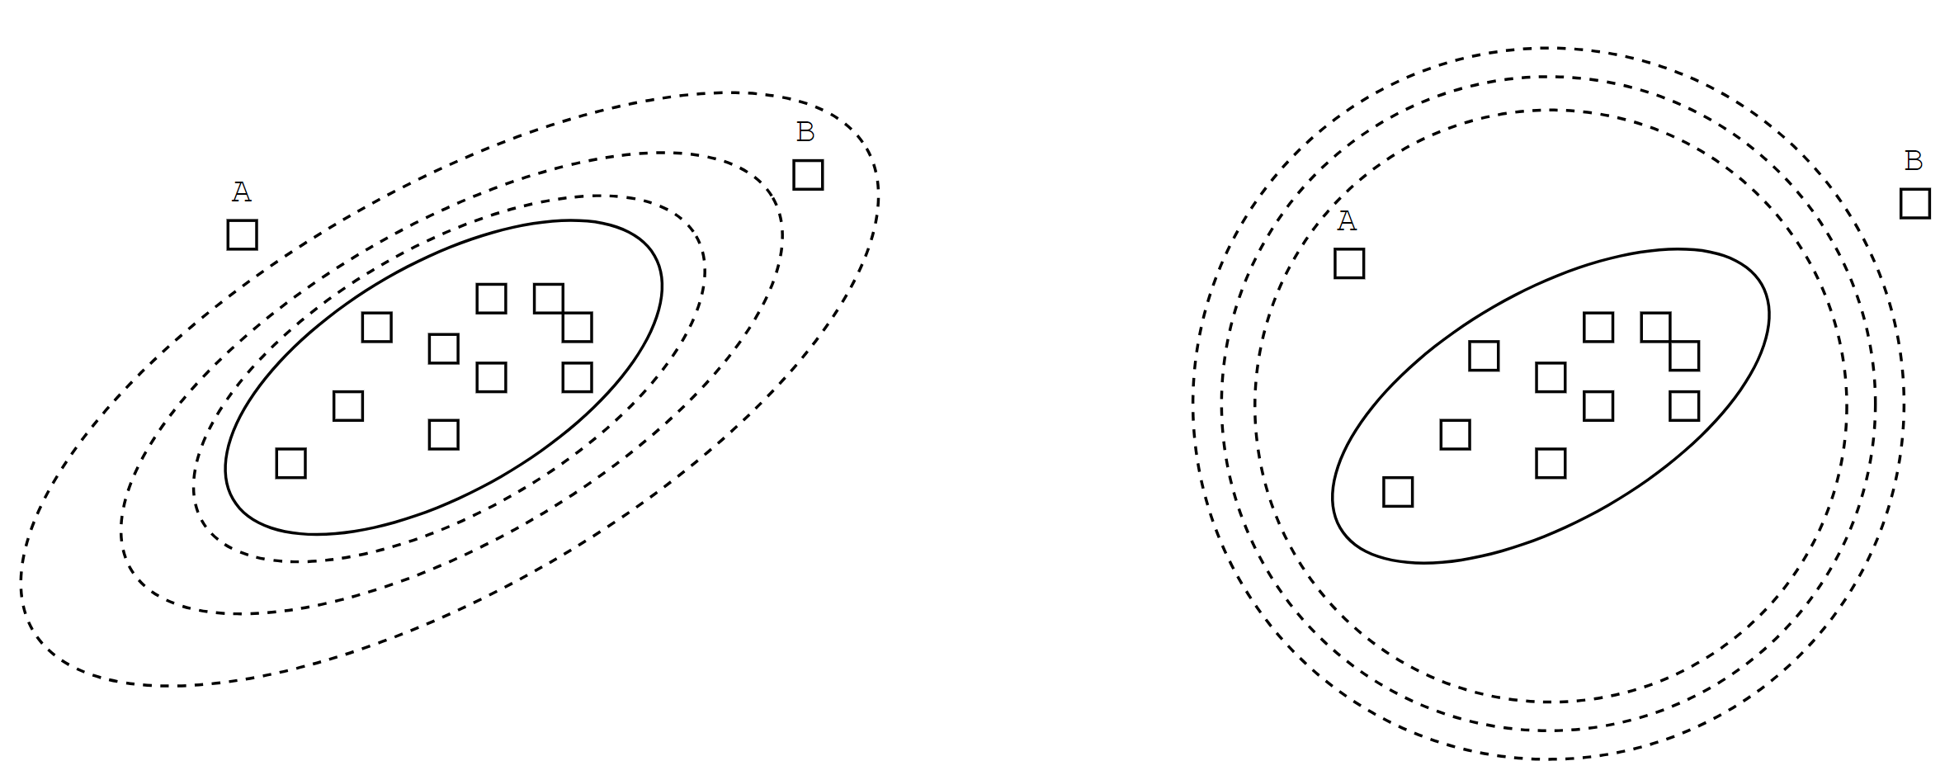
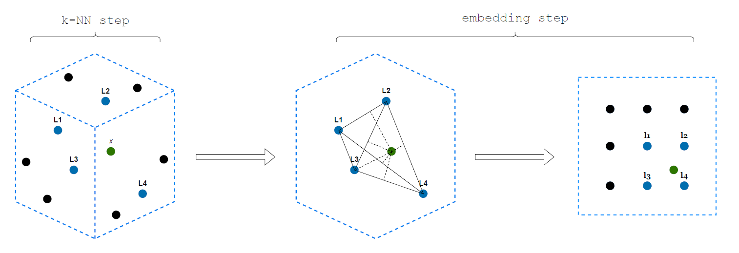
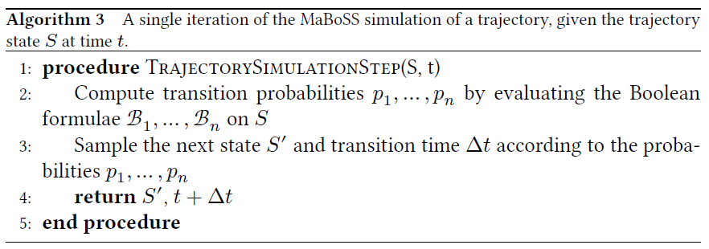
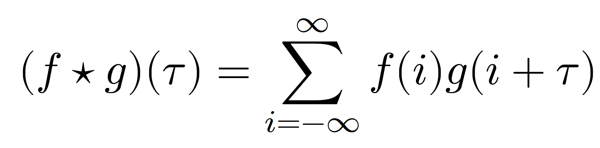
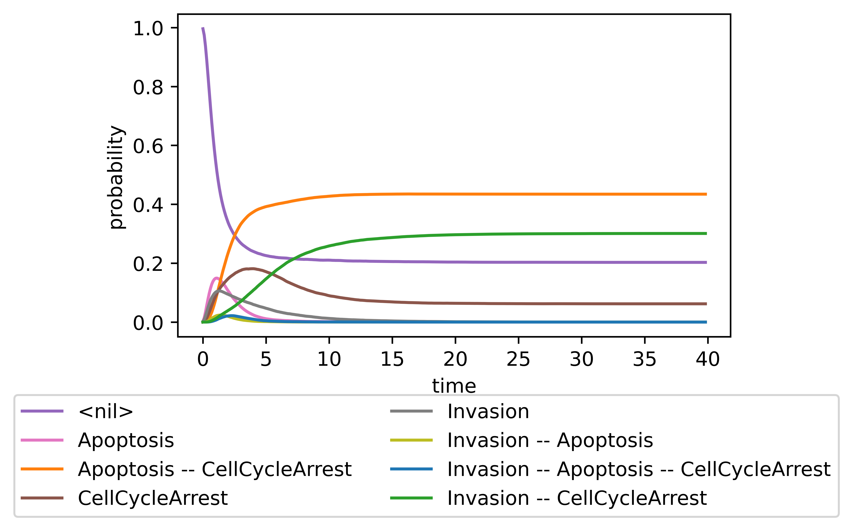
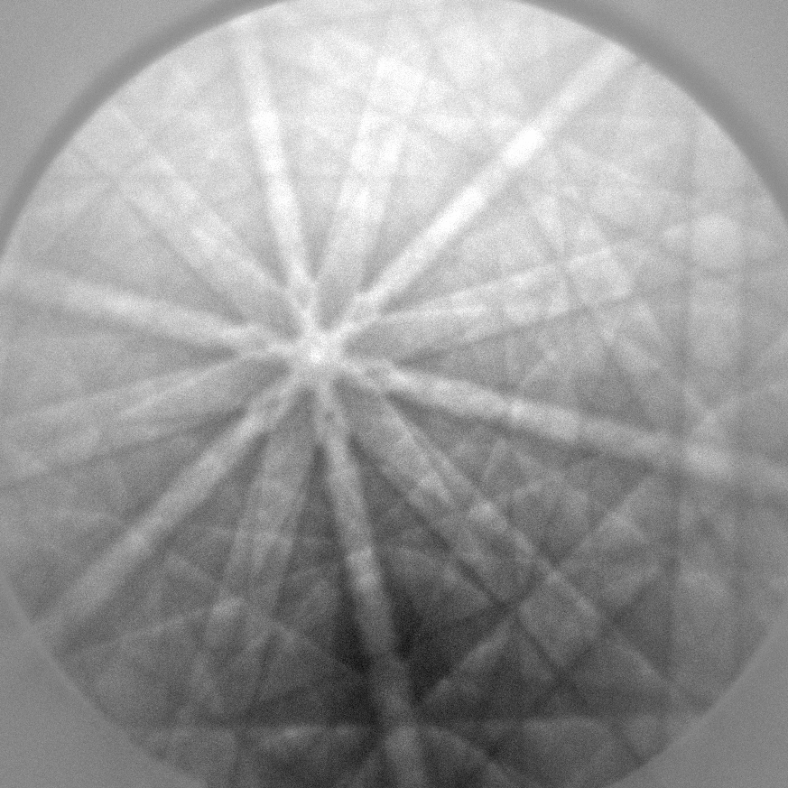
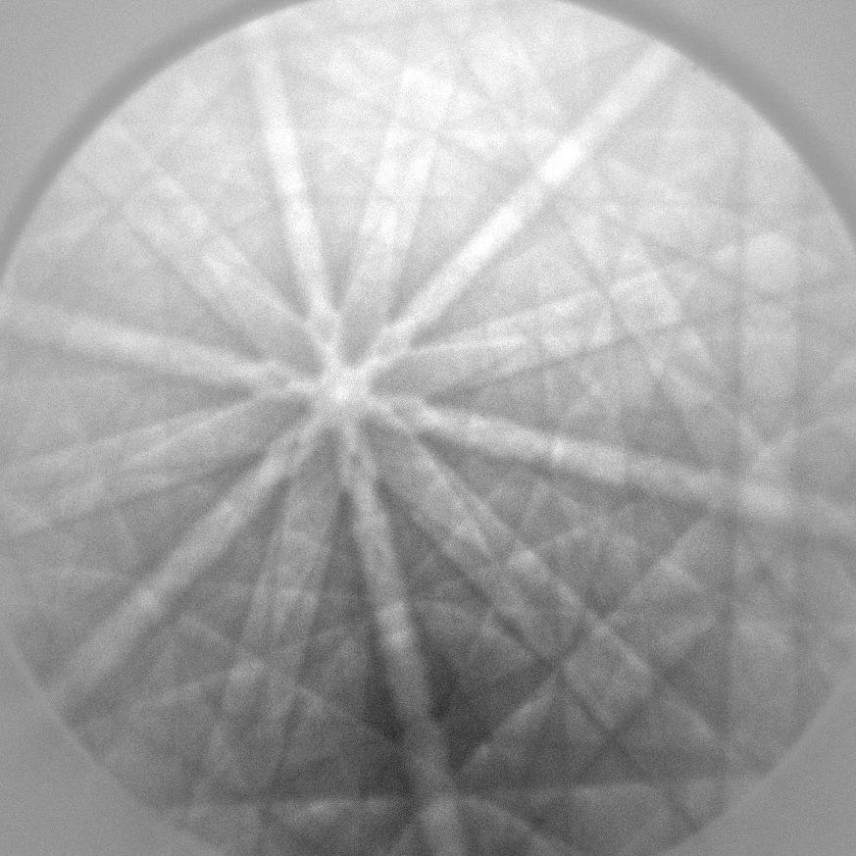
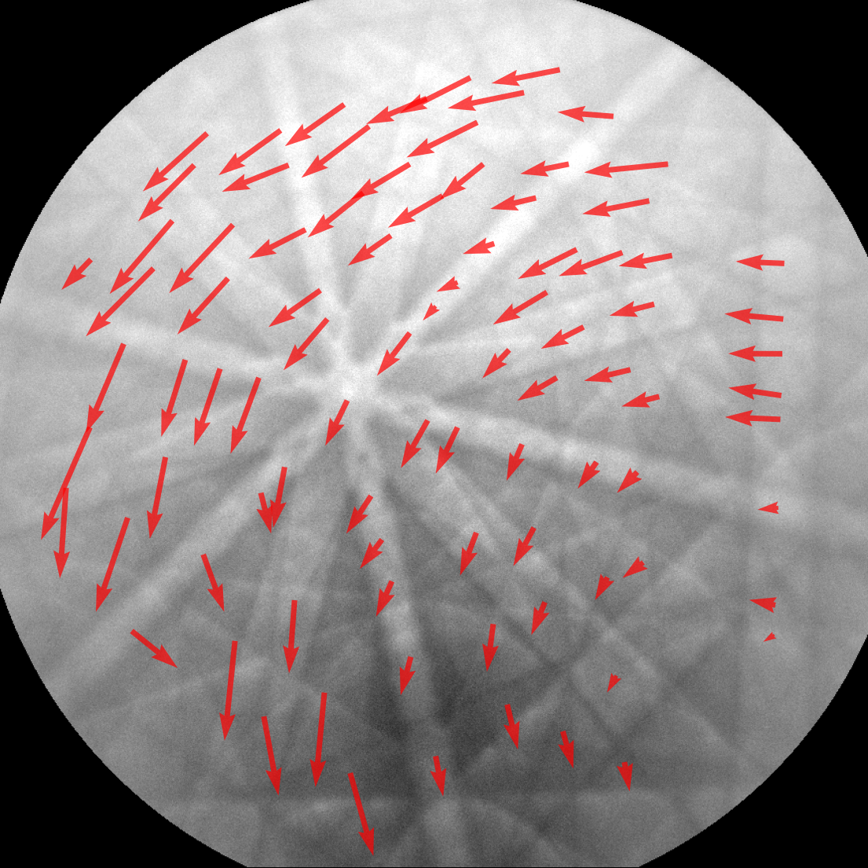
Exploiting GPU performance in scientific computing
1. Mahalanobis clustering
2. EmbedSOM
3. MaBoSS
4. Cross-Correlation
Reference pattern
Deformed pattern
Deformation visualization
Contributions 1-4
Notes:
// And these are the main challenges, one of many in GPGPU programming, that I and our research group had to tackle when working on these 4 scientific algorithms that I will present shortly.
I and our research group used the expertise to develop highly parallel GPU-optimized version of these 4 algorithm, with the similar main goal:
provide orders of magnitude speedups over the prior state-of-the-art
enabling domain scientists to finish their analyses in minutes instead of days
process more data with greater accuracy,
Interactively/real-time visualize the results
explore previously unattainable problem variations
-- Mame 4 alg – tieto chcu zlepsit na gpuckach bottomline

Slide 8
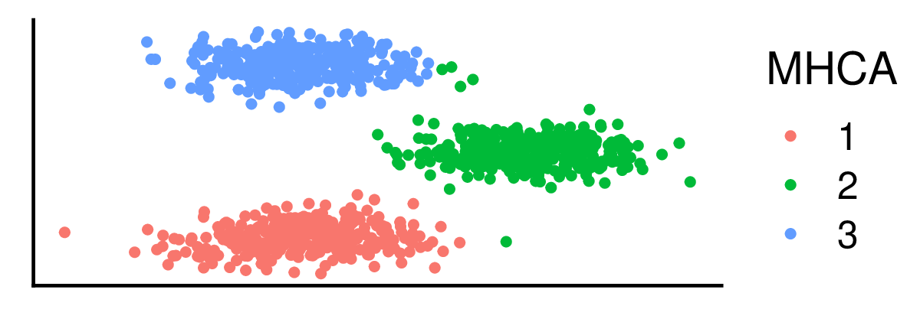
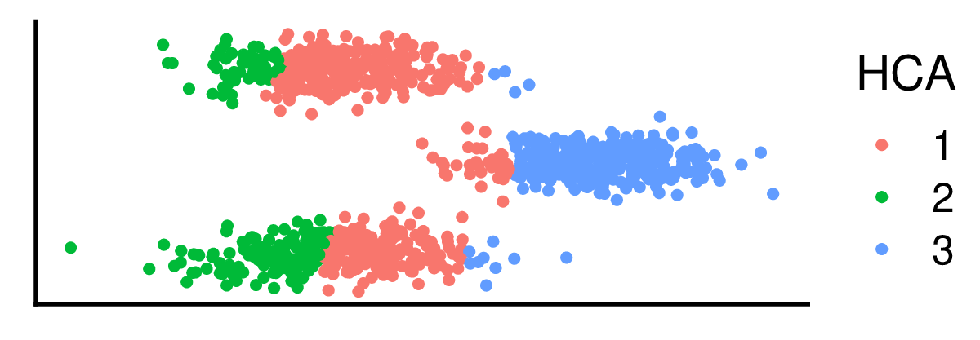
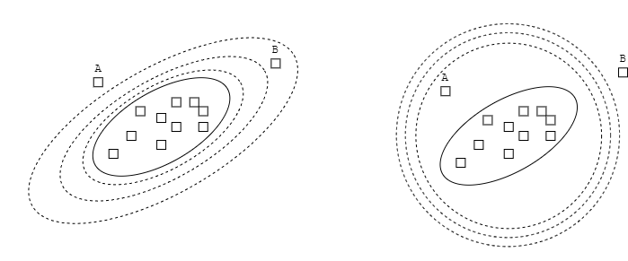
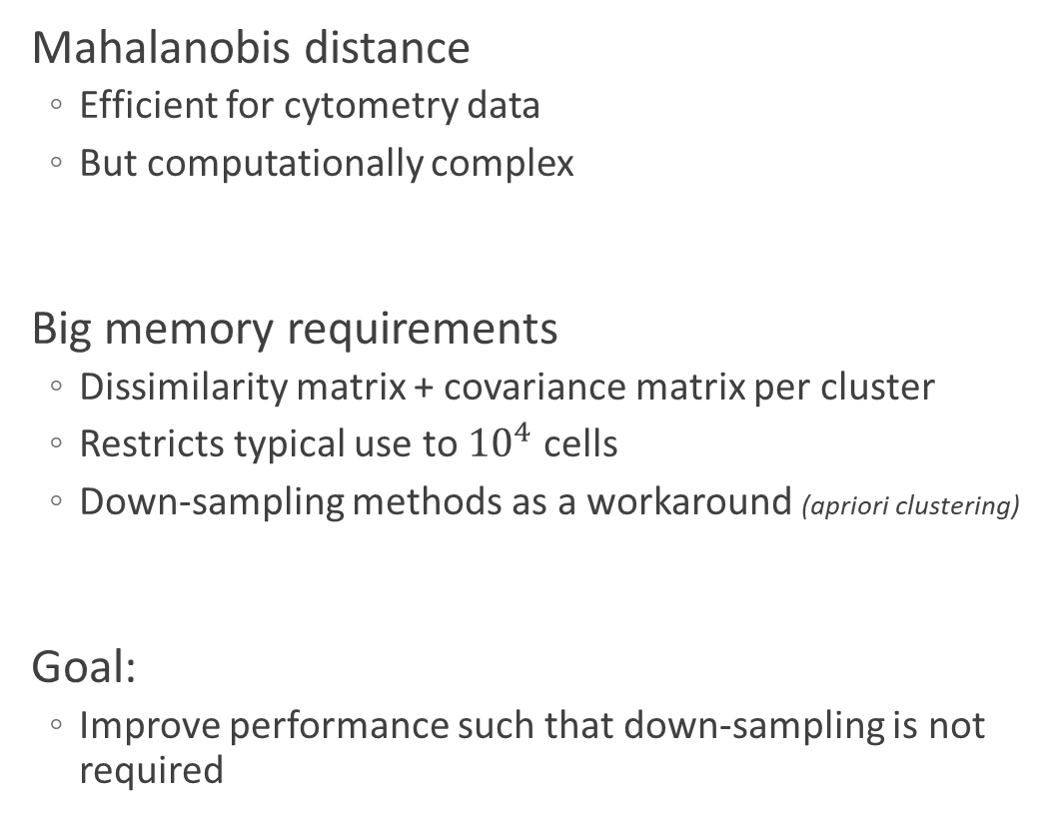
Mahalanobis-based hierarchical clustering
1 Mahalanobis clustering
1. Mahalanobis clustering
Mahalanobis distance
Efficient for cytometry data
But computationally complex
Big memory requirements
Dissimilarity matrix + covariance matrix per cluster
Restricts typical use to ${10}^{4}$ cells
Down-sampling methods as a workaround (apriori clustering)
Goal:
Improve performance such that down-sampling is not required
Mahalanobis distance
Euclidean distance
Mahalanobis distance
Euclidean distance
Notes:
The first algorithm was introduced to us by our colleagues from department of bioinformatics. The authors employed mahalanobis distance to hierarchically cluster cytometry datasets.
This distance is very suitable for cytometry datasets, because it respects the ellipsoid shapes of the clusters which are formed in this data very naturally.
However, the time and space requirements restricted the original implementation to very small datasets, requiring the use of down-sampling methods to analyze bigger datasets.
What makes this challenging when porting to gpus is load balancing, since each iteration of the algorithm, different number of dinstances needed to be computed for each cluster.
The performance goal here was that authors would be able to analyze typically used datasets without any down-sampling.
- Vratit sa ku bodu(om) … vysvettlit… cielom, zryhclit
- Ciel – viac s motivaciou – potreujeme to rychlejsie pretoze im to trva dlho chcu to na laptope ,. . . .

Slide 9
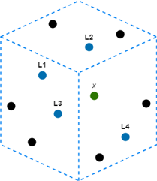
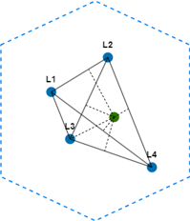
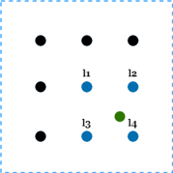
Interactive dimensionality reduction
2 EmbedSOM
2. EmbedSOM
t-SNE and UMAP have super-linear time complexity
EmbedSOM is designed for effectivity of visualization
Trains a much smaller model of data (using UMAP/t-SNE/SOM)
The rest of dataset is approximately embedded using the model
Goals:
Accelerate EmbedSOM to enable semi-supervised analysis
Real-time interactive visualization
k-NN step
embedding step
Notes:
Next, Embedsom is an alternative to dimensionality reduction tools, such as t-SNE and UMAP, which trades accuracy for linear time complexity.
So by design, EmbedSOM achieves linear scaling, being able to embed tens of millions of cells in hours instead of days when traditional tools are used.
A challenging part of porting this algorithm to GPU was fighting memory bottleneck, so various caching and latency hiding techniques were utilized.
The motivation for the porting was to accelerate embedsom enough such that the data could be processed real time and the parameters of the analysis could be changed in an intuitive and interactive manner.

Slide 10
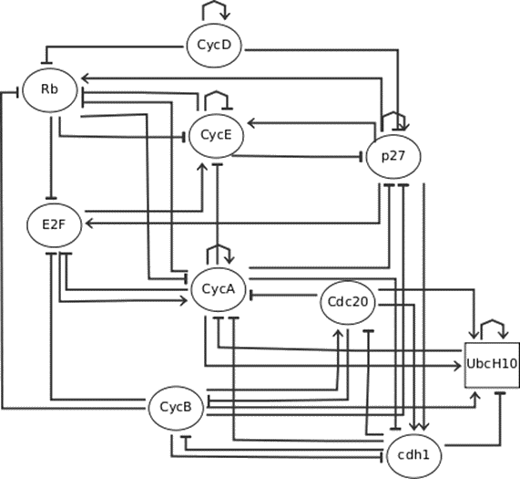
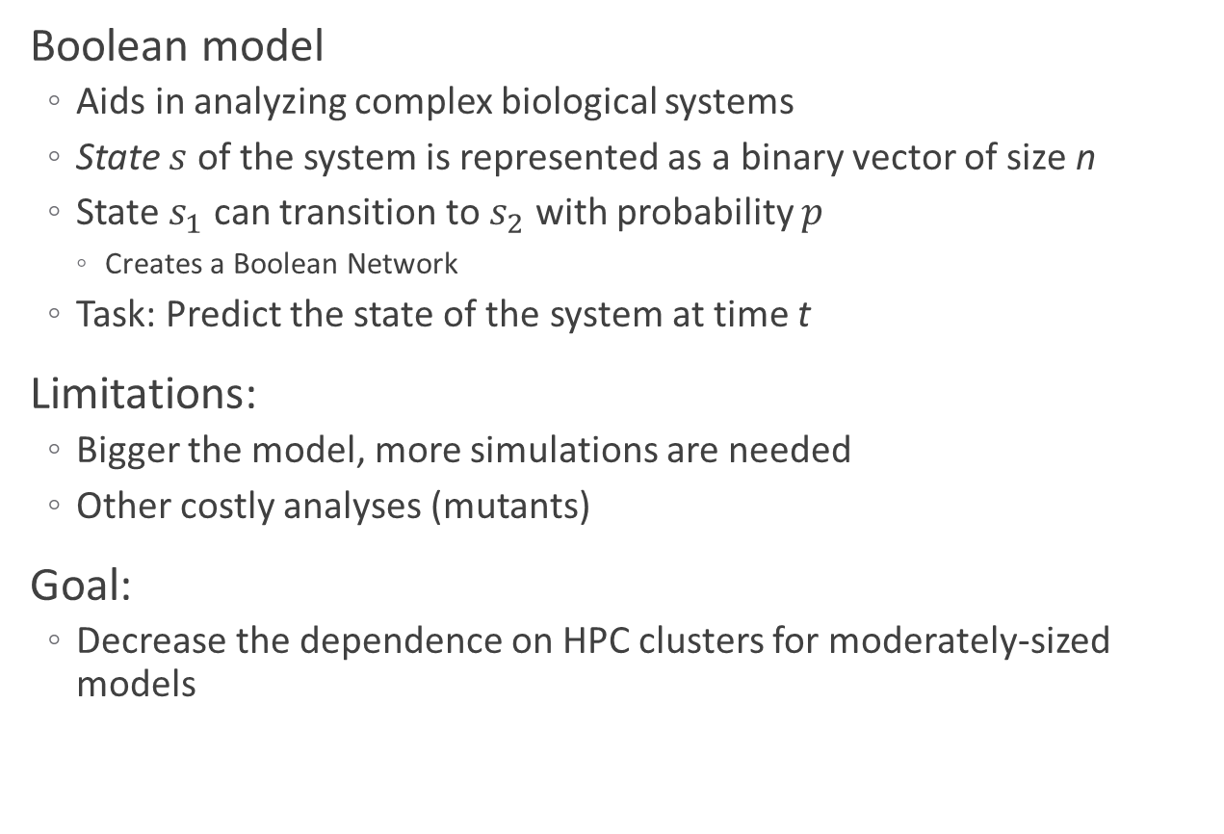
Monte-Carlo simulator of Boolean Models
3. MaBoSS
3. MaBoSS
Boolean model
Aids in analyzing complex biological systems
State $s$ of the system is represented as a binary vector of size n
State $s_{1}$ can transition to $s_{2}$ with probability $p$
Creates a Boolean Network
Task: Predict the state of the system at time t
Limitations:
Bigger the model, more simulations are needed
Other costly analyses (mutants)
Goal:
Decrease the dependence on HPC clusters for moderately-sized models
Mammalian cell cycle, Fauré et al.
Notes:
During my internship in institute curie, I was introduced to MaBoSS tool, used for simulating Boolean models.
Very simply a Boolean model tries to model a biological system by having nodes with Boolean values and some influence graph between them.
The state of the system is a vector - a concatenation of these Boolean values and a system can transition from one state to another, creating directed weighted graph.
Maboss uses kinetic monte carlo algorithm to simulate these systems.
The limitation of the current state of the art is that simulating bigger model with enough accuracy is problematic to compute in swiftly manner on contemporary computers.
However, GPU implementation needs to take care of keeping lockstep execution converged when dealing with evaluation of the influence graph.
The goal of GPU-accelerated variant is to allow scientists to solve moderately-sized variant on their gpu-equipped laptops instead of big HPC clusters.

Slide 11

Cross-correlation optimized for small inputs
4. Cross-Correlation
4. Cross-Correlation
Cornerstone to many algorithms
Image processing
Seismology
Material physics
…
Generally solvable by FFT
Huge overhead
Big room for improvements on smaller problem sizes
Goals:
Process the alloy images faster than they are produced by electron (EBSD) cameras
Reference pattern
Deformed pattern
Deformation visualization
Courtesy of Jozef Vesely from Department of Physics of Materials
Notes:
The last topic of this part, in which I would like to stay a little longer, is cross-correlation.
It is used in plethora of filedn and to my research group it was introduced by colleagues from departmeto of material physics.
They use it to compute the deformation pattern of an alloy subjected to various stresses, such as (…). Using crosscorr, physicists could find the vector of deformation on various places of the alloy.
Generally it is solvable by FFT, but its big overhead favors brute-force method.
The biggest issue with naïve gpu implementation is its very poor arithmetic intensity, which makes it heavily memory bottlenecked.
But designing an accelerated version of cross correlation especially for small batched inputs would allow physicists to process the images at the same rate that they are produced by their compicated cameras.
--- vela casu pri definicii a na FFT – je tu
--- samplovani je rychlejsie nez…

Slide 12
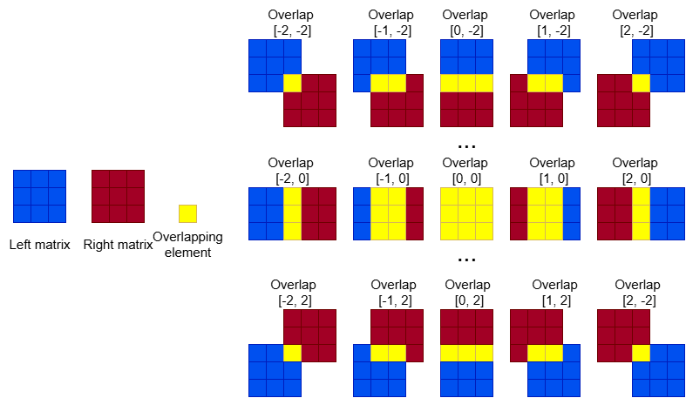
Cross-correlation – Optimization choices
4. Cross-Correlation
Simple and trivially-parallelizable base implementation
Imbalanced workload
Loading the same data multiple times
Poor arithmetic intensity
for (int i = -(n-1); i <= n-1; i++)
for (int j = -(n-1); j <= n-1; j++)
for (int y = 0; y < n - abs(i); y++)
for (int x = 0; x < n - abs(j); x++)
result[j][i] += a[max(0, -i) + y][max(0, -j) + x] *
b[max(0, i) + y][max(0, j) + x];
Notes:
And let me briefly stop at this contribution. In the next slides I would like to exemplify the process of developing efficient gpu code, which had to be done on all other presented contributions.
On the right you can see the tirival implementation. However, if we parallelize it over the first 2 loops, we get very imbalanced workload and very little data sharhing.
While, when you look at the example which shows neighboring overlaps of these 3x3 matrices, there is plenty of potential to share some loaded data between the overlaps.
Menej casu vysvetolvat
Message:
Data reuse treba to spravne usporiadat
Potencial je vekly

Slide 13
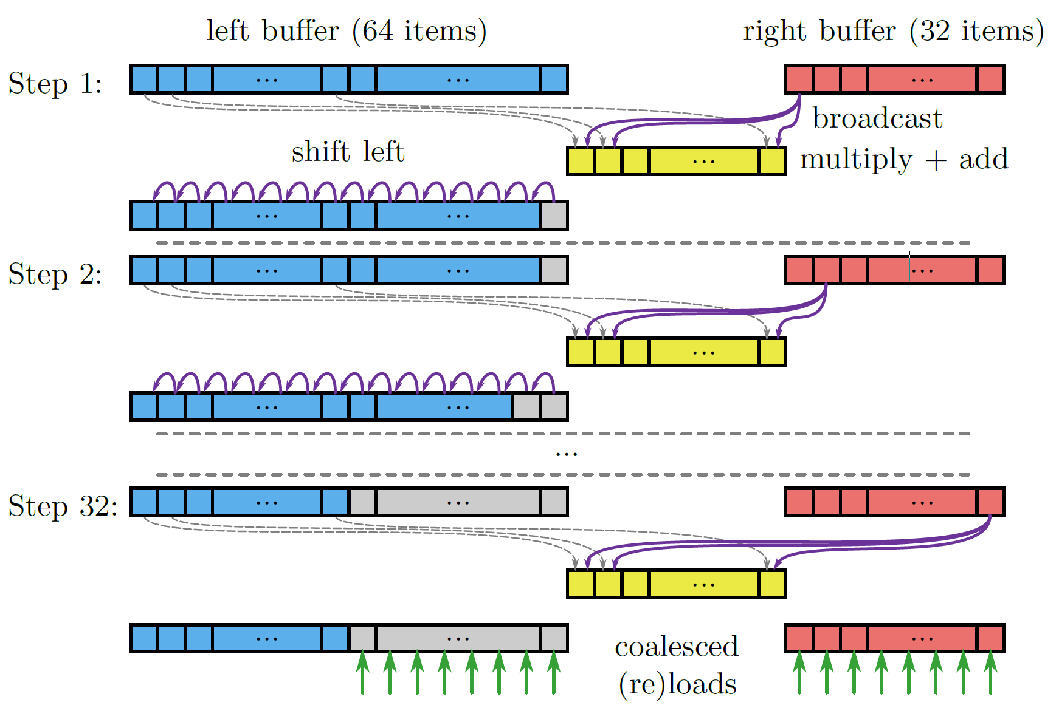
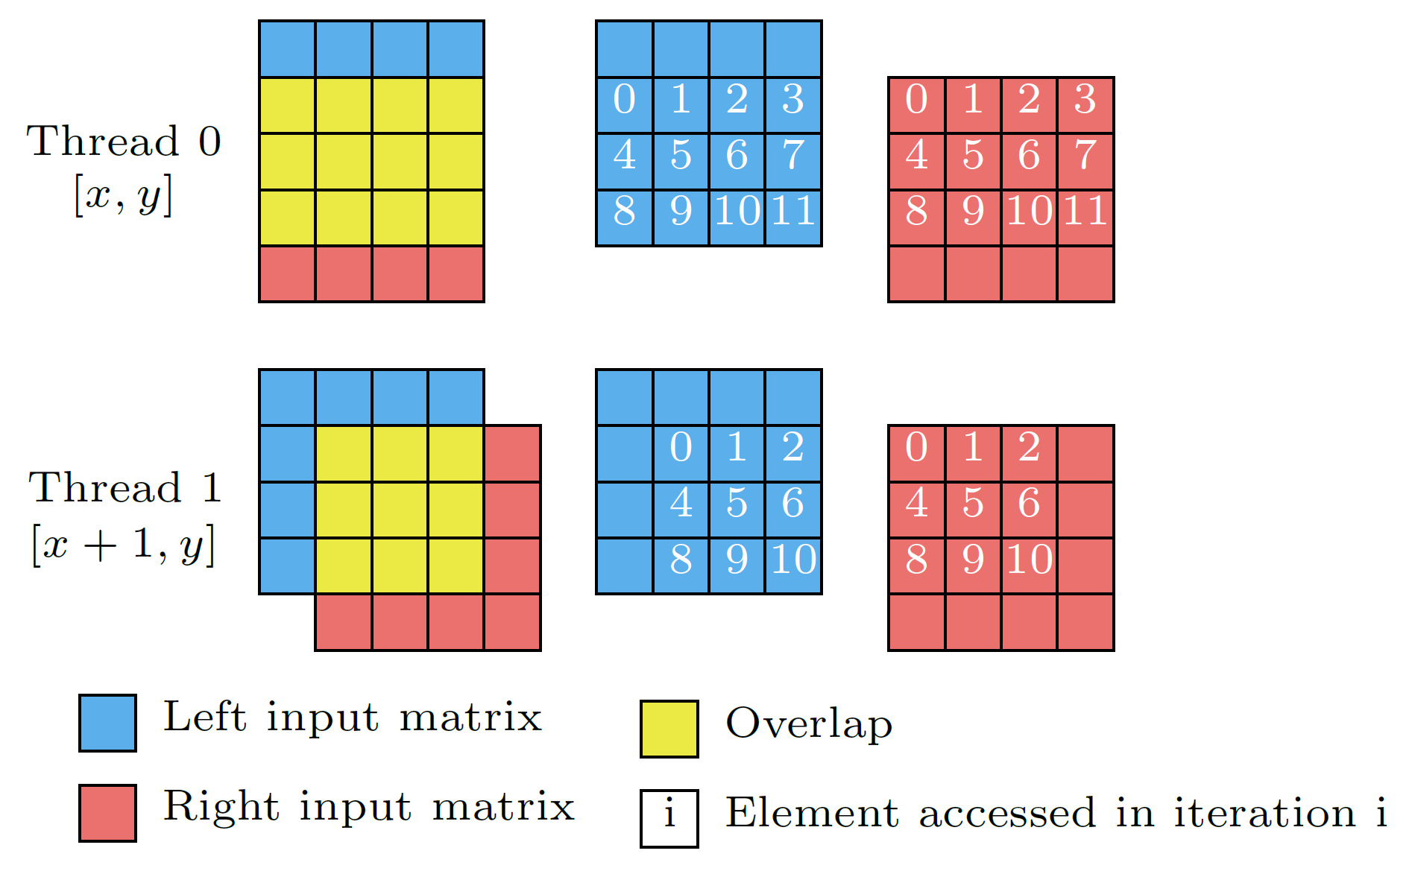
Cross-correlation – Optimization choices
4. Cross-Correlation
Sharing data between overlaps
Neighboring overlaps share a lot of points
Semi-regular data accesses
Caching in registers
Buffer divided across warp threads
Warp-shuffle instructions
Notes:
A more zoomed image on the left shows memory access pattern of neighboring overlaps.
This pattern can be exploited such that a portion of input data is loaded by the whole GPU warp just once, and reused by the threads for multiple computations.
There is a special family of instructions on GPUs, called warp shuffle and we were able to use them to make threads cooperatively exchange their data in registers.
That way, we were able to use the fastest memory on GPUs – the registers as our cache.
Message:
Mame special instrukce na gpu
My sme ju vedeli vyuzit
Vieme cachovat v registorch

Slide 14
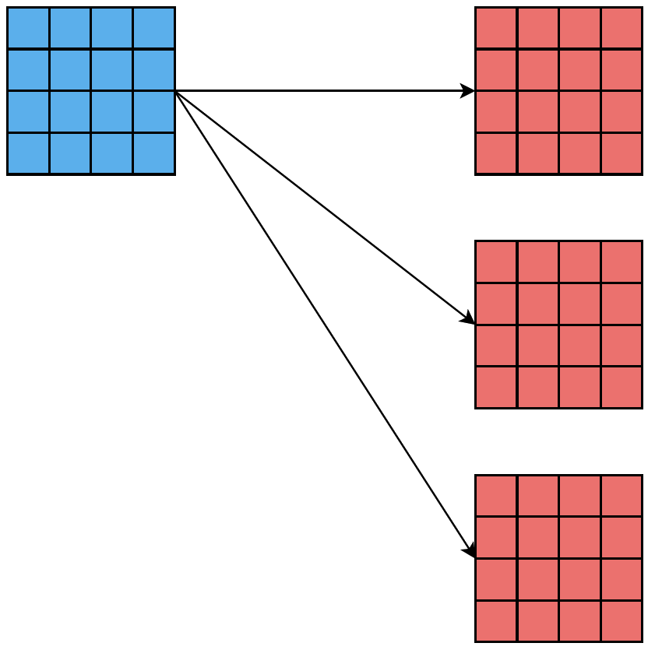
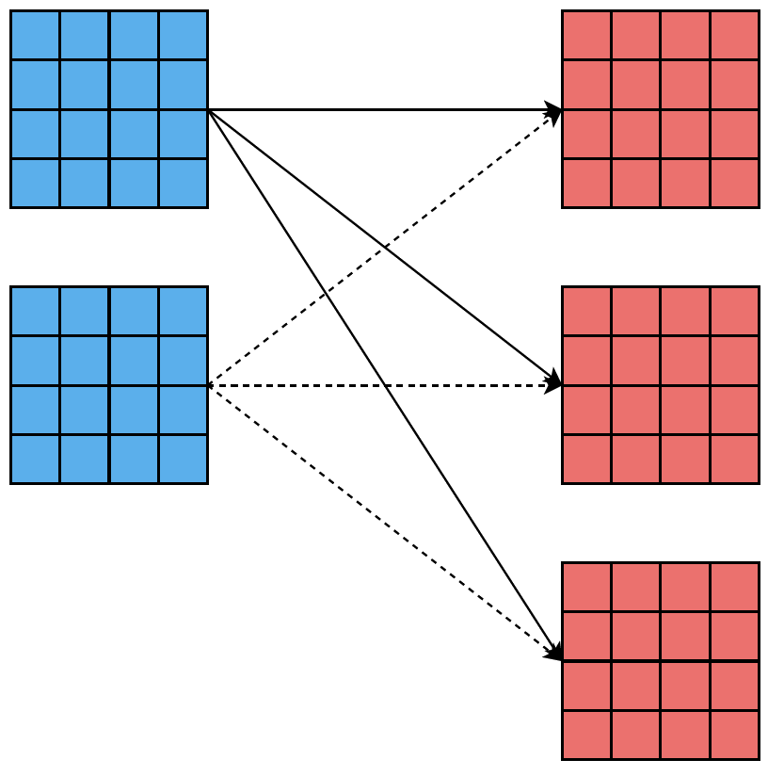
Cross-correlation – Optimization choices
4. Cross-Correlation
Different optimization opportunities for
Multiple right matrices (1:N problem)
Multiple left and right matrices (N:M problem)
Orthogonal way of sharing data to previous example
But GPU resources are limited
Requires experimental exploration of the ideal ratio
And other possible optimization variants:
Storing data in shared memory instead of registers
Different workload distribution
Warp per overlap
Thread per overlap row
…
Notes:
And there are much more choices of optimization.
Naturally, for 1:N problems or N:M problems, there are other caching possibilities.
These optimizations are independent of the previous examples, which means that they can be combined.
And we developed an optimized solution for each of them.
For different problem instances, such as cross correlation one left matrix with multiple right matrices or multiple left matrices with multiple right matrices, there is another data reuse potential, which is orthogonal to the example I showed on the previous slide.
The gpu registers are not unlimited so the ideal ratio of different sharing levels have to be experimnetaly validated.
And there are many other possible variants, such as different workload distribution when resource utilization drops and so on and so on
Tech choices je vela – vyriesili sme ho zv ciac pohaldov
Teraz om vam ukazal jede samplik – tu su dalsie aha mame optim postup

Slide 15
Results of porting scientific algorithms to GPUs
1. Mahalanobis clustering
2. EmbedSOM
3. MaBoSS
4. Cross-Correlation
Contributions 1-4
Notes:
And applying this careful design and many experimental iterations, porting scientific algorithms to gpus enabled us to bridge huge performance gaps, resulting in
- Viac pridat kontex a polievku

Slide 16
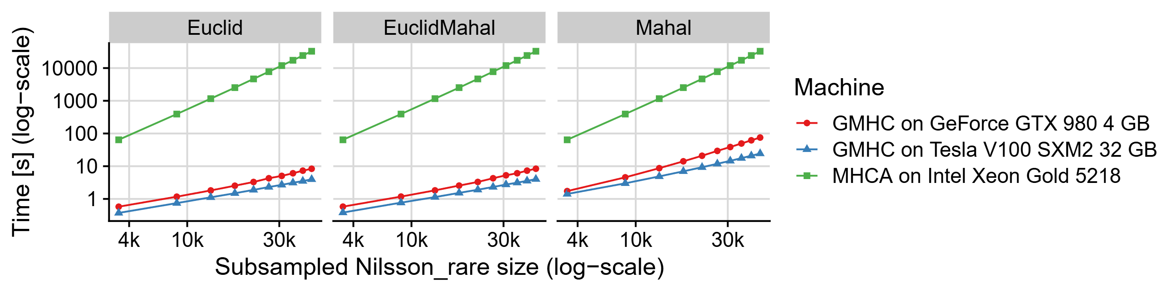
Results of porting scientific algorithms to GPUs
1. Mahalanobis clustering
2. EmbedSOM
3. MaBoSS
4. Cross-Correlation
Adam Šmelko et al. “GPU-Accelerated Mahalanobis-Average Hierarchical Clustering Analysis”
European Conference on Parallel Processing. Springer. 2021
Contributions 1-4
Notes:
Optimized Mahalanobis clustering with 1000x speedup, allowing to analyze real-world datasets with 1M of points and 30 dimensions in minutes instead of days.

Slide 17
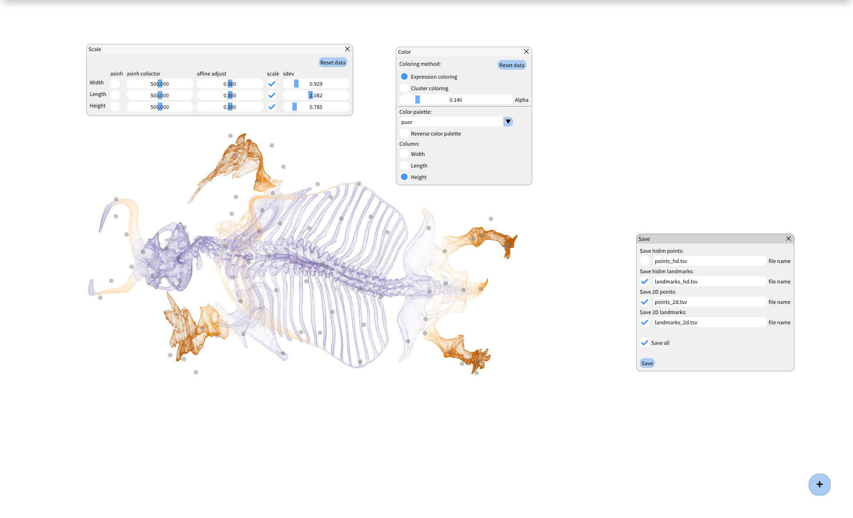
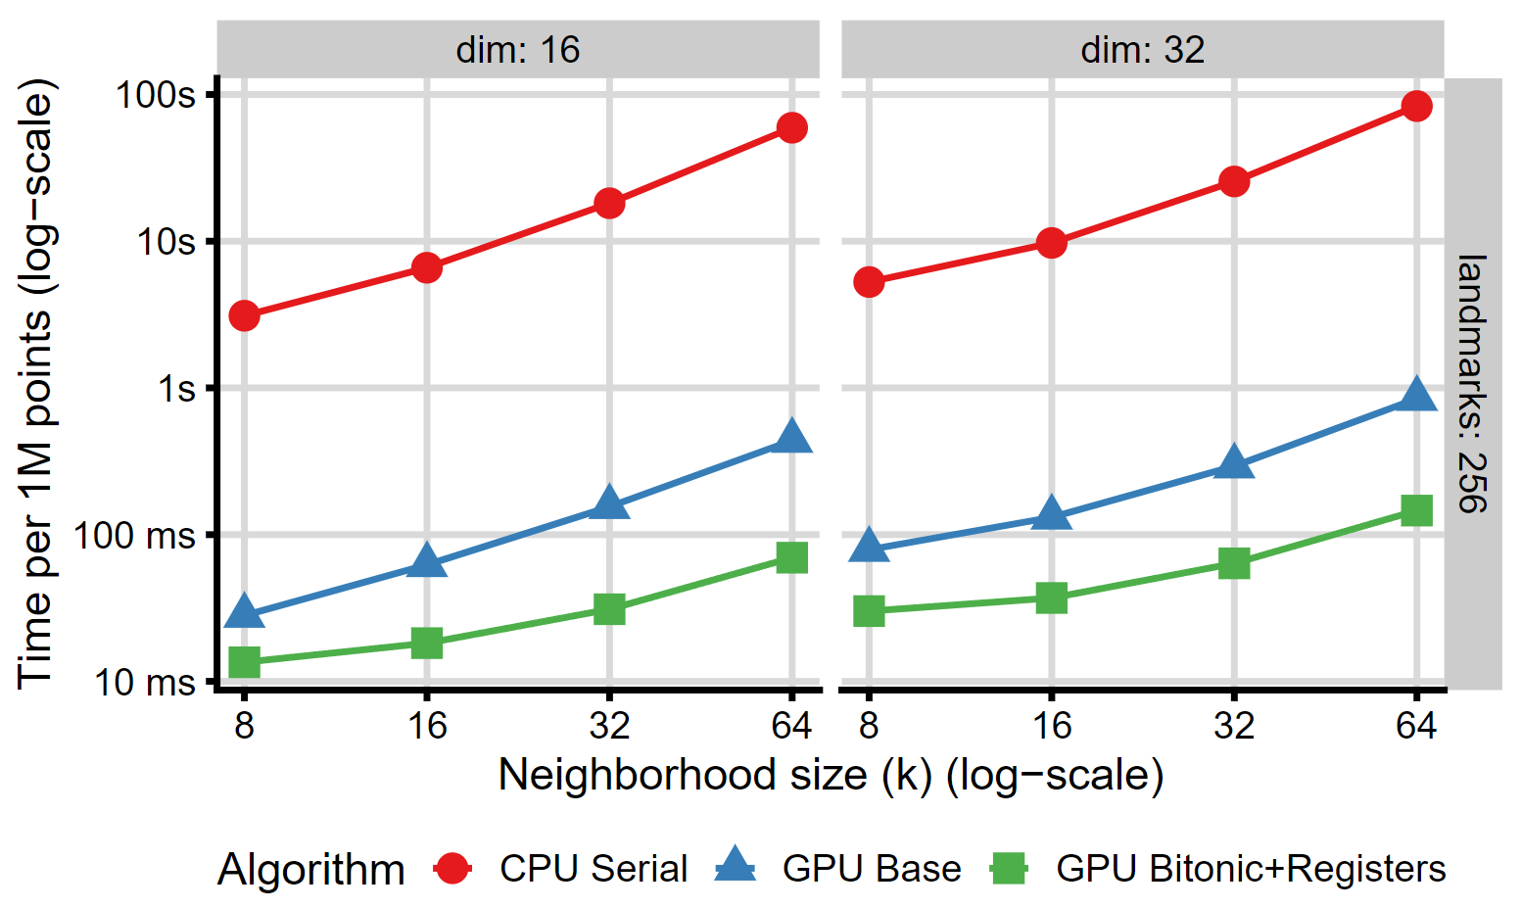
Results of porting scientific algorithms to GPUs
1. Mahalanobis clustering
2. EmbedSOM
3. MaBoSS
4. Cross-Correlation
Adam Šmelko et al. “GPU-acceleration of neighborhood-based dimensionality reduction algorithm EmbedSOM”
16th Workshop on General Purpose Processing Using GPU. Association for Computing Machinery, 2024
Contributions 1-4
Notes:
Accelearted embedSOM, with over 10x speedup compared to naïve GPU code, enabled interactive visualization and was integrated into the graphicall application called BlosSOM and is able to process datasets with 1m of points in a manageable framerate of 30fps.

Slide 18
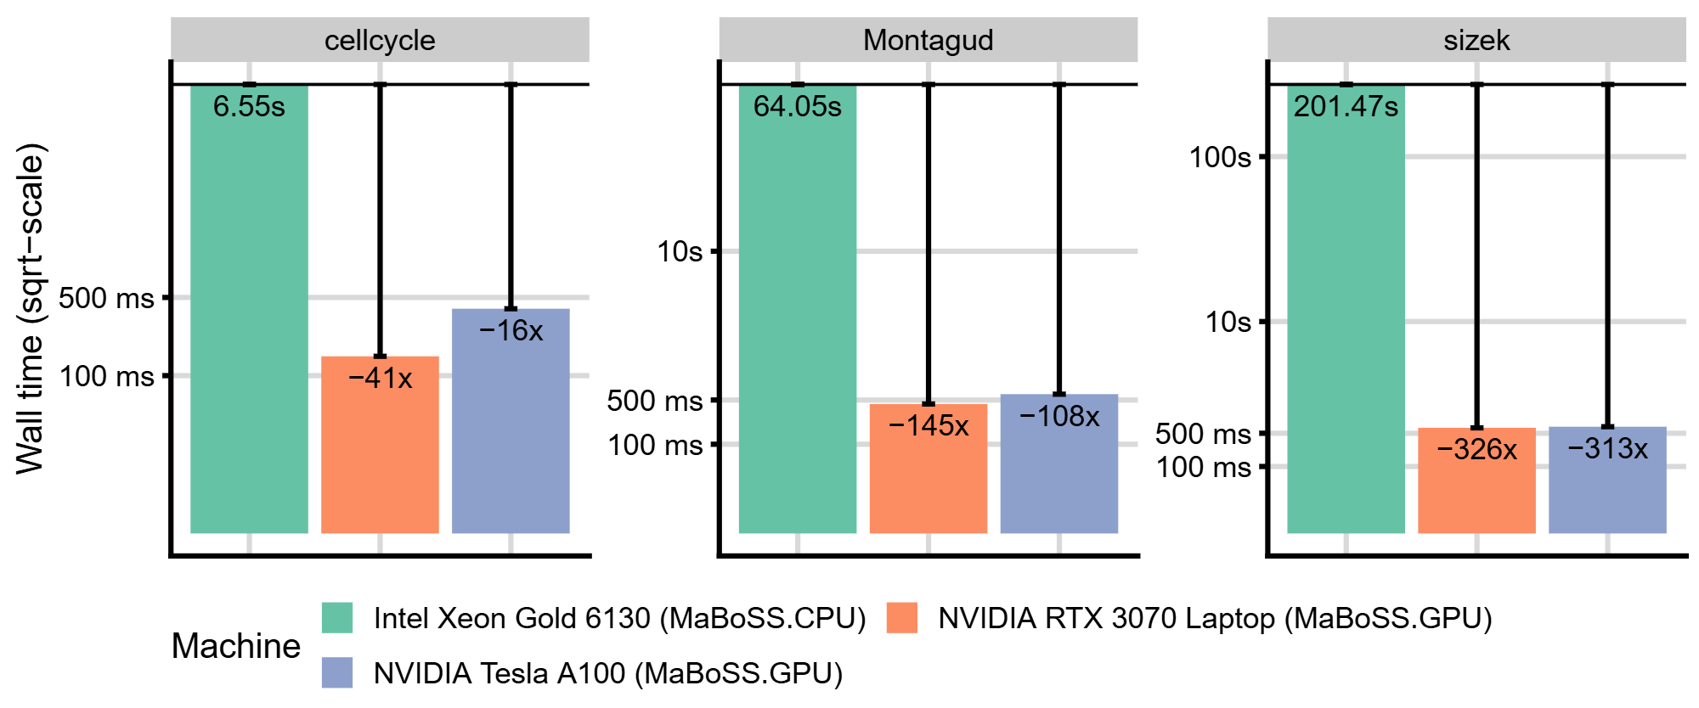
Results of porting scientific algorithms to GPUs
1. Mahalanobis clustering
2. EmbedSOM
3. MaBoSS
4. Cross-Correlation
Adam Šmelko et al. “Maboss for HPC environments: implementations of the continuous time Boolean model simulator for large CPU clusters and GPU accelerators”
BMC bioinformatics 25 (2024)
Contributions 1-4
Notes:
GPU Maboss, mutant analysis no longer belongs just to the domain of supercomputers but could become
feasible on data center-grade GPUs.

Slide 19
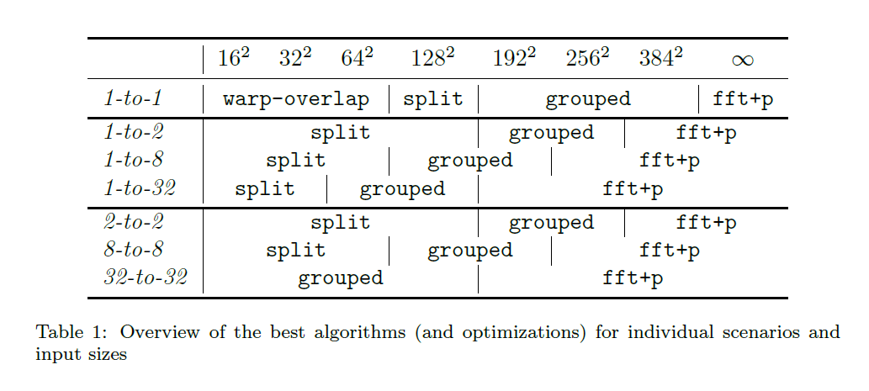
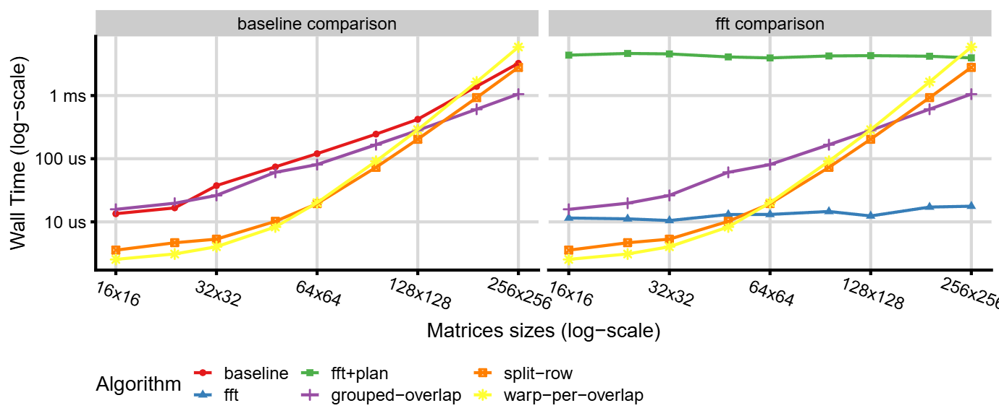
Results of porting scientific algorithms to GPUs
1. Mahalanobis clustering
2. EmbedSOM
3. MaBoSS
4. Cross-Correlation
Karel Maděra et al. “Efficient GPU-accelerated Parallel Cross-correlation”
In the second review round in Journal of Parallel and Distributed Computing (2024)
Contributions 1-4
Notes:
And improved Cross corr can enable physicists to analyze alloy deformations at the same and higher rate than EBSD cameras.

Slide 20
Streamlining memory optimizations
Contributions 5-6
Notes:
And now for the second part

Slide 21
Memory related optimizations
Many scientific algorithms revolve around single ‘master’ data structure
Optimizing accesses to the data structure is imperative
Layout
Traversal
In widely-used languages (C++/Java/Python), such code is written ad-hoc
Unmaintainable
Not self-documenting
Error-prone
for (int i1 = 0; i1 < I / tile_I; i1++)
for (int j1 = 0; j1 < J / tile_J; j1++)
for (int k1 = 0; k1 < K / tile_K; k1++)
for (int i2 = 0; i2 < tile_I; i2++)
for (int j2 = 0; j2 < tile_J; i2++)
for (int k2 = 0; k2 < tile_K; k2++)
// i=i1*tile_I+i2, j=j1*tile_J+j2, k=k1*tile_K+k2
Notes:
Now, reflecting on the biggest challenges of the scientific algorithms that I described,
The most important opotimizations related to memory –
be it access to cell vectors in Mahalanobis distance
Or various caching mechanisms in EmbedSOM and cross-correlation.
If I generalize this for all scientific algorithms, we may say that virtually all of them revolve around some master data structure – be it vector of points, matrices, or multidimensional grid, sparse matrices …
Optimizing memory accesses for this data structure is immensely important.
But generally in imperative programming languages, the code that relates to these optimizations is written ad-hoc.
Have a look at this code, it shows the 6 level nested loop, the iterating a 3d indexing space by tiles. The problem here is that this code is
Difficult subject to modification, just by looking at it you can hardly tell what it does and also it contains a copy paste mistake.
Podivajte sa – jejda …
Pridat context s minulym vyskumom
Viac k meritu veci – potrebujeme layout navrhut tak aby to bolo lepsie pre programatora, unmaintainable, to je to co sa snazime zlepsit … aby nam to zhorsilo performance … lepsie sw engineeringovksy kod
Viac delkarativne hovorit co sa v kode deje – dava nam to agnosticitu …

Slide 22


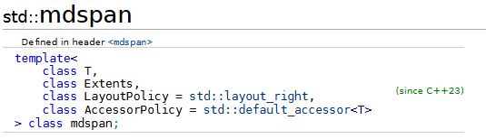

Aims: Streamlining memory layouts
Indexing abstraction for layouts
Reuse layout across data structures
Composability into complex layouts
Notes:
So it would be a great help if we had a tool, that would streamline these coding tasks for a programmer.
Creating an indexing abstraction that would be lightweight enough to not pose additional overhead and also provide extensible and declarative way of defining layouts of data structures.
All with honoring well established sw engineering practices.
And to signify the importance of this topic, big communities such as C++ comitte and nvidia come with their own solutions to this problem, such as mdspan and CuTe Layouts.
Zverejnii sme to prvi – robia to ini dava zmysel to robit …
Podivajte sa – jejda …
Pridat context s minulym vyskumom
Viac k meritu veci – potrebujeme layout navrhut tak aby to bolo lepsie pre programatora, unmaintainable, to je to co sa snazime zlepsit … aby nam to zhorsilo performance … lepsie sw engineeringovksy kod
Viac delkarativne hovorit co sa v kode deje – dava nam to agnosticitu …

Slide 23
Noarr Layouts
5. Noarr Layouts
Indexing abstraction for layouts
Reuse layout across data structures
Composability into complex layouts
Notes:
So we developed noarr layouts, pure C++ tool, that tries to tackle this problem. Let me quickly present its design.

Slide 24
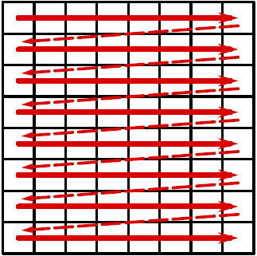
Noarr Layouts
5. Noarr Layouts
m[15 * n + 54]
j
Indexing abstraction for layouts
Reuse layout across data structures
Composability into complex layouts
m[i * n + j]
m[y * n + x]
i
auto row_major_layout = noarr::scalar<float>() ^ noarr::vector<'j'>(5) ^ noarr::vector<'i'>(3);
j
'j'
0
1
2
3
4
i
5
6
7
8
9
'i'
a
b
c
d
e
auto col_major_layout = noarr::scalar<float>() ^ noarr::vector<'i'>(3) ^ noarr::vector<'j'>(5);
Notes:
Imagine a matrix and its common notation where I stnds for row index and j stands for column index.
If we wanted to code row major layout of this matrix, we would need to write this indexing function on every occasion where the matrix is used, without a mistake.
Using noarr, we define a layout object once, which clearly states the layouting intentions.
It is composed of building blocks, such as scalar, vectors which specify the name and size of the dimension, which compose together and create row major matrix layout, with the indexing wired in the object.
A column major matrix layout would be defined by swithicng the vector building vlocks
--- zjednodusit tie body
Indexing abstrction for different layotus
Rychlejsie – element riadok stlpec
Mame jednotny indexing

Slide 25
Noarr Layouts
5. Noarr Layouts
Indexing abstraction for layouts
Reuse layout across data structures
Composability into complex layouts
Layout
Storage
Binding
auto layout =
noarr::scalar<float>() ^
noarr::vectors<'j', 'i'>(5, 3);
float* storage = new float[5 * 3];
__shared__ float storage[5 * 3];
noarr::make_bag(layout, storage);
void* storage = mmap(nullptr, 4 * 5 * 3, …, fd, 0);
Notes:
So in our design, a loayout is a first class citizen, which makes it easy to reuse in different parts of code.
Not only that, it can be reused in different memory addresses and spaces.
So disregarding whether the matrix is stored in CPU main memory, GPU shared memory, or mmaped file, we can bind it to that storage to interpret the slice of memory however we want
Zase digetovat
U binding sa netrapit

Slide 26
Noarr Layouts
5. Noarr Layouts
Encapsulate basic indexing features into self-describing envelopes
Reuse layout across data structures
Provide a lightweight indexing abstraction
Expressive means to declare complex layouts
auto layout = noarr::scalar<float>() ^ noarr::vectors<'j', 'i'>(5, 4);
auto bag = noarr::make_bag(layout, storage);
'j'
'j'
0
1
2
3
4
0
1
2
3
4
5
6
7
8
9
5
6
7
8
9
'i'
10
11
12
13
14
'i'
10
11
12
13
14
15
16
17
18
19
15
16
17
18
19
float x = bag.at<'i', 'j'>(1, 2);
float y = bag.at<'j', 'i'>(1, 2);

Slide 27
Noarr Layouts
5. Noarr Layouts
Indexing abstraction for layouts
Reuse layout across data structures
Composability into complex layouts
auto row_l = noarr::scalar<float>() ^ noarr::vector<'j'>(5) ^ noarr::vector<'i'>(3);
'J'
'j'
'j'
'j'
row_l
row_l
0
1
2
3
4
'i'
5
6
7
8
9
0
1
2
3
4
'I'
10
11
12
13
14
'i'
row_l
row_l
5
6
7
8
9
15
16
17
18
19
10
11
12
13
14
'i'
15
16
17
18
19
auto tiled_l =
row_l ^ noarr::vector<'J'>(2)
^ noarr::vector<'I'>(2);
auto submatrix_l =
row_l ^ noarr::slice<'i'>(1, 2)
^ noarr::slice<'j'>(1, 3);
Notes:
The property of concatenating simple building blocks into layout allows for very neat definition of complex layout.
So we can extend the existing layout into 2 other dimensions, creating tiled matrix layout.
Or we can create a subview of a layout.
In these cases, writing the indexing function by hand starts to be really tough.
3. Composability
Promotuje reusabilitu

Slide 28
Noarr Layouts
5. Noarr Layouts
Indexing abstraction for layouts
Reuse layout across data structures
Composability into complex layouts
Consequence: Layout-agnostic code
template <class A_bag_t, class B_bag_t, class C_bag_t>
void matmul(A_bag_t& A, B_bag_t& B, C_bag_t& C)
{
for (int i = 0; i < A.get_length<'i'>(); i++)
for (int j = 0; j < A.get_length<'j'>(); j++)
for (int k = 0; k < B.get_length<'k'>(); k++)
C.at<'i', 'k'>(i, k) += A.at<'i', 'j'>(i, j) * B.at<'j', 'k'>(j, k);
}
Notes:
The last use case that I would like to show for this contribution is so called layout-agnostic code.
Since layouts are first class citizens, thay can be passed to a function as a parameter.
See this code, it is a matrix multiplication code. But since the layouts are the parameters of this function, the function stays the same disregarding the layouts of the 3 matrices are used.
The indexing has effectively become an object / coding task that could be developed and optimized independently – which improves the software design.
- Viac k pointe

Slide 29
The other perspective: Streamlining memory traversal
We would like to have this abstraction for the algorithm too
Plenty of tools for loop transformations
Mainly compiler- or annotation-based
Does not promote good software design
template <class A_bag_t, class B_bag_t, class C_bag_t>
void matmul(A_bag_t& A, B_bag_t& B, C_bag_t& C)
{
for (int i = 0; i < A.get_length<'i'>(); i++)
for (int j = 0; j < A.get_length<'j'>(); j++)
for (int k = 0; k < B.get_length<'k'>(); k++)
C.at<'i', 'k'>(i, k) +=
A.at<'i', 'j'>(i, j) *
B.at<'j', 'k'>(j, k);
}
// loop reordering
#pragma clang loop(i, j) interchange permutation(j, i)
for (int i = 0; i < n; i++)
for (int j = 0; j < m; j++)
// loop tiling
#pragma clang loop(i, j) tile sizes(4, 8)
for (int i = 0; i < n; i++)
for (int j = 0; j < m; j++)
Notes:
Lets look at this from another perspective.
The other piece of code, that generates the memory accesses, and complements layouts, are the nested loops.
They guide the order in which operations of the algorithm execute.
what if we could have the same benefits such as encapsulation and separation of concerns on this part of code as well?
So this change of operation order is typically referred to loop transformation and they very well researched topic.
There are compiler and annotation based tools out there, but their downside is that for big enough codebase thay may become impractival and typically they are closed to mure complex extensions.
Cesta straightforth c++ je tazky - noarr
Chyba prechod
- datove struktury updatovat vieme , ako updatovat algoritmus
- pragmy neprakticke
- zle sw eng

Slide 30
Noarr Traverser – Tiling matrix multiply
6. Noarr Traversers
float* A = new float[I * J];
float* B = new float[J * K];
float* C = new float[I * K];
for (int i = 0; i < I; i++)
for (int j = 0; j < J; j++)
for (int k = 0; k < K; k++)
C[i * K + k] += A[i * J + j] * B[j * K + k];
auto A = noarr::make_bag(noarr::scalar<float>() ^ noarr::vectors<'i', 'j'>(I, J));
auto B = noarr::make_bag(noarr::scalar<float>() ^ noarr::vectors<'j', 'k'>(J, K));
auto C = noarr::make_bag(noarr::scalar<float>() ^ noarr::vectors<'i', 'k'>(I, K));
noarr::traverser(A, B, C) | [=] (auto state)
{
C.at(state) += A.at(state) * B.at(state);
}
Plain C++
Noarr C++
Observation:
In a nested sequence of loops, each loop can be interpreted as a named dimension of a layout
Notes:
Let me present the last contribution of my thesis, noarr traverser.
Which applies the same principles as with Noarr layouts, but on the sequence of nested loops.
I will present the main benefit of the traverser on this example of improving matrix multiplication code by reordering the operation into tiles for better caching oportunitites.
On the left, there is a plain C++ code of trivial natrix multiply.
On the right, I present the layouts of the matrices A B C and the new traverser obhect, which represents the sequence of nested loops. This sequence is generated by extracting the indexing space from the passed layouts. And the rest is a layout agnostic line equivalent to the line on the left.
Now, lets do the transformation, step by step.
Imperative vs declarative
Lavy Reusovatelny?
Viac rozsiritelny

Slide 31
Noarr Traversers – Tiling matrix multiply
6. Noarr Traversers
float* A = new float[I * J];
float* B = new float[J * K];
float* C = new float[I * K];
for (int i = 0; i < I / 32; i++)
for (int j = 0; j < J; j++)
for (int k = 0; k < K; k++)
for (int ii = 0; ii < 32; ii++)
C[(i * 32 + ii) * K + k] +=
A[(i * 32 + ii) * J + j] *
B[j * K + k];
auto A = noarr::make_bag(noarr::scalar<float>() ^ noarr::vectors<'i', 'j'>(I, J));
auto B = noarr::make_bag(noarr::scalar<float>() ^ noarr::vectors<'j', 'k'>(J, K));
auto C = noarr::make_bag(noarr::scalar<float>() ^ noarr::vectors<'i', 'k'>(I, K));
auto order = noarr::into_blocks<'i', 'I', 'i'>(32);
noarr::traverser(A, B, C) ^ order | [=] (auto state)
{
C.at(state) += A.at(state) * B.at(state);
}
Plain C++
Noarr C++
Tile the first (i) loop
Notes:
First, we tile the first loop. On the left you can see that it required a bunch of changes to various places. While on the left we just make use of a building block, which divides the first loop (denoted by character I) into blocks and is applied onto traversal.

Slide 32
Noarr Traversers – Tiling matrix multiply
6. Noarr Traversers
float* A = new float[I * J];
float* B = new float[J * K];
float* C = new float[I * K];
for (int i = 0; i < I / 32; i++)
for (int j = 0; j < J / 32; j++)
for (int k = 0; k < K; k++)
for (int ii = 0; ii < 32; ii++)
for (int jj = 0; jj < 32; jj++)
C[(i * 32 + ii) * K + k] +=
A[(i * 32 + ii) * J + j * 32 + jj] *
B[(j * 32 + jj) * K + k];
auto A = noarr::make_bag(noarr::scalar<float>() ^ noarr::vectors<'i', 'j'>(I, J));
auto B = noarr::make_bag(noarr::scalar<float>() ^ noarr::vectors<'j', 'k'>(J, K));
auto C = noarr::make_bag(noarr::scalar<float>() ^ noarr::vectors<'i', 'k'>(I, K));
auto order = noarr::into_blocks<'i', 'I', 'i'>(32)
^ noarr::into_blocks<'j', 'J', 'j'>(32);
noarr::traverser(A, B, C) ^ order | [=] (auto state)
{
C.at(state) += A.at(state) * B.at(state);
}
Plain C++
Noarr C++
Tile the second (j) loop
Notes:
Next goes tiling of the second loop, which again results in many changes on the left, and just one new building block on the right

Slide 33
Noarr Traversers – Tiling matrix multiply
6. Noarr Traversers
float* A = new float[I * J];
float* B = new float[J * K];
float* C = new float[I * K];
for (int i = 0; i < I / 32; i++)
for (int j = 0; j < J / 32; j++)
for (int k = 0; k < K / 32; k++)
for (int ii = 0; ii < 32; ii++)
for (int jj = 0; jj < 32; jj++)
for (int kk = 0; kk < 32; kk++)
C[(i * 32 + ii) * K + k * 32 + kk] +=
A[(i * 32 + ii) * J + j * 32 + jj] *
B[(j * 32 + jj) * K + k * 32 + kk];
auto A = noarr::make_bag(noarr::scalar<float>() ^ noarr::vectors<'i', 'j'>(I, J));
auto B = noarr::make_bag(noarr::scalar<float>() ^ noarr::vectors<'j', 'k'>(J, K));
auto C = noarr::make_bag(noarr::scalar<float>() ^ noarr::vectors<'i', 'k'>(I, K));
auto order = noarr::into_blocks<'i', 'I', 'i'>(32)
^ noarr::into_blocks<'j', 'J', 'j'>(32)
^ noarr::into_blocks<'k', 'K', 'k'>(32);
noarr::traverser(A, B, C) ^ order | [=] (auto state)
{
C.at(state) += A.at(state) * B.at(state);
}
Plain C++
Noarr C++
Tile the third (k) loop
Notes:
The same goes here. You can see that the difference of the changes that on the left we do imperative programming, while on the right we can specify the changes in a self-describing, error-free declarative way.
And again, this process makes this nested loop the object that can be modified independently.

Slide 34
Noarr Traversers – Tiling matrix multiply
6. Noarr Traversers
float* A = new float[I * J];
float* B = new float[J * K];
float* C = new float[I * K];
for (int i = 0; i < I / 32; i++)
for (int k = 0; k < K / 32; k++)
for (int j = 0; j < J / 32; j++)
for (int ii = 0; ii < 32; ii++)
for (int kk = 0; kk < 32; kk++)
for (int jj = 0; jj < 32; jj++)
C[(i * 32 + ii) * K + k * 32 + kk] +=
A[(i * 32 + ii) * J + j * 32 + jj] *
B[(j * 32 + jj) * K + k * 32 + kk];
auto A = noarr::make_bag(noarr::scalar<float>() ^ noarr::vectors<'i', 'j'>(I, J));
auto B = noarr::make_bag(noarr::scalar<float>() ^ noarr::vectors<'j', 'k'>(J, K));
auto C = noarr::make_bag(noarr::scalar<float>() ^ noarr::vectors<'i', 'k'>(I, K));
auto order = noarr::into_blocks<'i', 'I', 'i'>(32)
^ noarr::into_blocks<'j', 'J', 'j'>(32)
^ noarr::into_blocks<'k', 'K', 'k'>(32)
^ noarr::reorder<'I','K','J','i','k','j'>();
noarr::traverser(A, B, C) ^ order | [=] (auto state)
{
C.at(state) += A.at(state) * B.at(state);
}
Plain C++
Noarr C++
Reorder for more serial access
Notes:
And lastly, we can also do some reordering. Switching j and k pairs for more serial accesses.

Slide 35
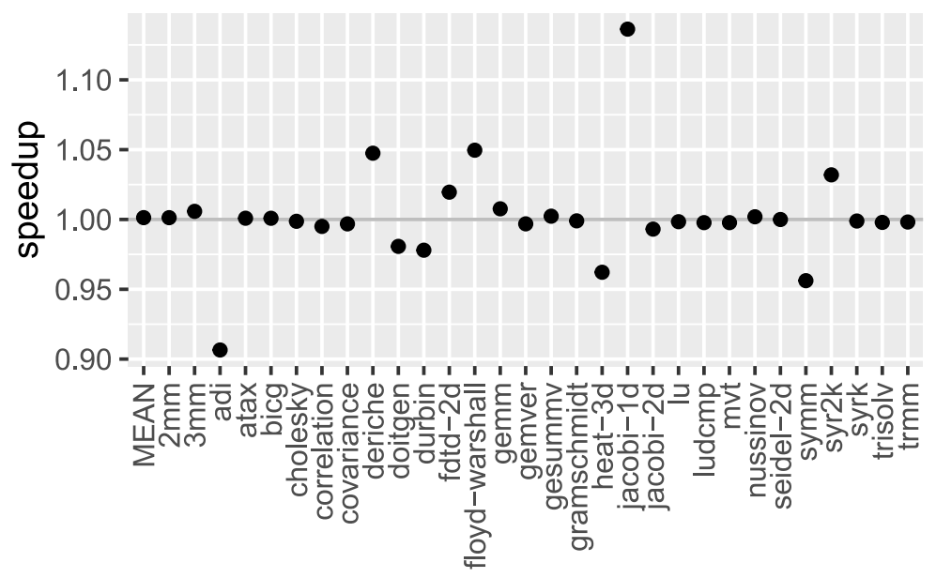
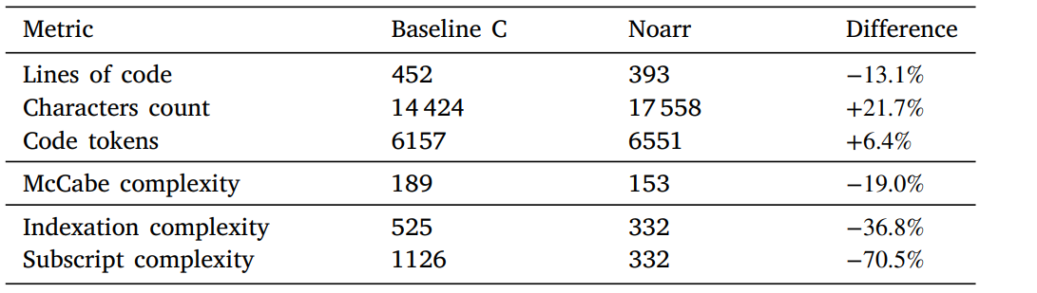
Noarr Results
Experimental tool
Open-source GitHub project
Lightweight
Both in runtime & coding overhead
Validated on Polybench suite
Research directions
Autotuning of layout- and traversal-agnostic functions
Adam Šmelko et al. “Astute Approach to Handling Memory Layouts of
Regular Data Structures”. International Conference on Algorithms and
Architectures for Parallel Processing. Springer. 2022
Jiří Klepl et al. “Pure C++ Approach to Optimized Parallel Traversal of Regular
Data Structures”. Proceedings of the 15th International Workshop on
Programming Models and Applications for Multicores and Manycores. 2024
Contributions 5-6
Notes:
TO sum up, noarr library is experimental open source tool, that tries to bring good softeare design practices into new places of code.
An that is abstraction for indexing, reusability, separation of concerns and declarative error-free way of programming.
It is lightweight enough to not pose significant overhead and these benefits come at a cost of slightly bigger verbosity.
We validated these claims on Polybench suite, which houses various computation kernels from many fields.
The next research direction of our research group is extending the agnostic properties of noarr an plugging autotuning frameworks into the code so the best layouting and looping variants are found automatically for us.
linear algebra computations, image processing, physics simulation, dynamic programming, statistics, etc.

Slide 36
Summary
Thank you for attention!
GPU-accelerated implementations for selected scientific computations
New experimental tool in HPC programmer’s toolkit
6 papers (2 journals, 2 conference proceedings, 2 workshop proceedings)
Adam Šmelko et al. “GPU-Accelerated Mahalanobis-Average Hierarchical Clustering Analysis” European Conference on Parallel Processing (2021)
Adam Šmelko et al. “Maboss for HPC environments: implementations of the continuous time Boolean model simulator for large CPU clusters and GPU accelerators” BMC bioinformatics (2024)
Adam Šmelko et al. “Astute Approach to Handling Memory Layouts of Regular Data Structures” International Conference on Algorithms and Architectures for Parallel Processing (2022)
Adam Šmelko et al. “GPU-acceleration of neighborhood-based dimensionality reduction algorithm EmbedSOM” Workshop on General Purpose Processing Using GPU (2024)
Karel Maděra et al. “Efficient GPU-accelerated Parallel Cross-correlation” In the second review round in Journal of Parallel and Distributed Computing (2024)
Jiří Klepl et al. “Pure C++ Approach to Optimized Parallel Traversal of Regular Data Structures” International Workshop on Programming Models and Applications for Multicores and Manycores (2024)
Almost entire collaboration:
Significant collaboration:
Limited collaboration:
Notes:
In summary,
I presented the performance advancements in 4 scientific algorithms that enabled scientists to work with their datasets more effectively, increasing accuracy interactivity or the dataset size.
And I presented a new experimental tool in HPC programmer’s toolkit that should enable writing complex memory optimizations seamlessly.
These contribution were published in 6 papers, 2 being journals, 2 conference and 2 workshop proceedings.
Here is the list of publications divided according to the size of the contribution.
With this I would like to conclude my presentation. Thank you fro the attention!

Slide 37
Reviewer comments and questions

Slide 38
Is Noarr used outside of our department?
No. Noarr is an experimental tool used for our projects and purposes, so far.
But it is readily available on GitHub!
Notes:
In development,
Only one paper reference

Slide 39
Is Noarr interoperable with OpenMP/compiler auto-vectorization?
Interoperability with OpenMP vectorization: Yes, but simd pragma does not understand traverser code.
void f(float* __restrict__ a, float* __restrict__ b, float* __restrict__ c, int n)
{
auto bag_a = noarr::make_bag(noarr::scalar<float>() ^ noarr::vector<'i'>(n), a);
auto bag_b = noarr::make_bag(noarr::scalar<float>() ^ noarr::vector<'i'>(n), b);
auto bag_c = noarr::make_bag(noarr::scalar<float>() ^ noarr::vector<'i'>(n), c);
#pragma omp simd
for (int i = 0; i < n; i++)
{
bag_c.at<'i'>(i) = bag_a.at<'i'>(i) + bag_b.at<'i'>(i);
}
}
$ g++ -std=c++20 -O3 -fopt-info-vec-optimized -march=native -fopenmp test.cpp
noarr-structures/include/noarr/structures/structs/layouts.hpp:136:11: optimized: loop vectorized using 32 byte vectors
noarr-structures/include/noarr/structures/structs/layouts.hpp:136:11: optimized: loop vectorized using 16 byte vectors
noarr-structures/include/noarr/structures/structs/layouts.hpp:136:11: optimized: loop vectorized using 32 byte vectors
Notes:
Pragma omp simd does not work

Slide 40
Is Noarr interoperable with OpenMP/compiler auto-vectorization?
Interoperability with OpenMP vectorization: Yes, but simd pragma does not understand traverser code.
Interoperability with compiler auto-vectorization: Yes.
void f(float* __restrict__ a, float* __restrict__ b, float* __restrict__ c, int n)
{
auto bag_a = noarr::make_bag(noarr::scalar<float>() ^ noarr::vector<'i'>(n), a);
auto bag_b = noarr::make_bag(noarr::scalar<float>() ^ noarr::vector<'i'>(n), b);
auto bag_c = noarr::make_bag(noarr::scalar<float>() ^ noarr::vector<'i'>(n), c);
noarr::traverser(bag_a, bag_b, bag_c) | [=] (auto state)
{
bag_c.at(state) = bag_a.at(state) + bag_b.at(state);
};
}
$ g++ -std=c++20 -O3 -fopt-info-vec-optimized -march=native test.cpp
noarr-structures/include/noarr/structures/extra/traverser.hpp:191:29: optimized: loop vectorized using 32 byte vectors
noarr-structures/include/noarr/structures/extra/traverser.hpp:191:29: optimized: loop vectorized using 16 byte vectors
Notes:
Pragma omp simd does not work

Slide 41
Is it possible to specify padding in Noarr?
No specific building block for that, but it can be (partially) simulated by slice.
'j'
0
1
2
3
4
5
6
7
8
9
10
11
12
13
14
'i'
15
16
17
18
19
auto layout3 =
row_l ^ noarr::slice<'j'>(0, 4);
Notes:
Noarr does not have a building block specifically for it but slice can do effectively what you want.

Slide 42
Was Noarr library utilized in presented scientific algorithms?
No, Noarr was developed later than many of the mentioned algorithms.
Some could be reimplemented using Noarr (perhaps one day…) but some would not benefit it at all.
We are working on projects with many stencil kernels, where Noarr can shine.

Slide 43
Did you consider comparing GPU-optimized variants with vectorized multicore CPU code?
The goal was to develop GPU implementation and compare it to the current state-of-the-art. In many cases, there was no parallel&vectorized CPU code to compare against.
In the mentioned sci. papers, SotA was:
Serial CPU code (Mahalanobis distances)
Parallel CPU code (MaBoSS)
Naïve GPU code (Cross-Correlation, EmbedSOM)
Notes:
Agree that this could be done – it was the work that we did not choose to pursue.

Slide 44
The thesis does not contain detailed evaluation section.
The thesis was written as the extended summary of presented papers.
Instead of delving into optimization details and performance evaluation (which is in the papers), I wanted to pay more attention to the background and bring a deeper understanding of the motivation (which is not in the papers).

